Slide 1
Event briefing
Race to the king

Slide 2
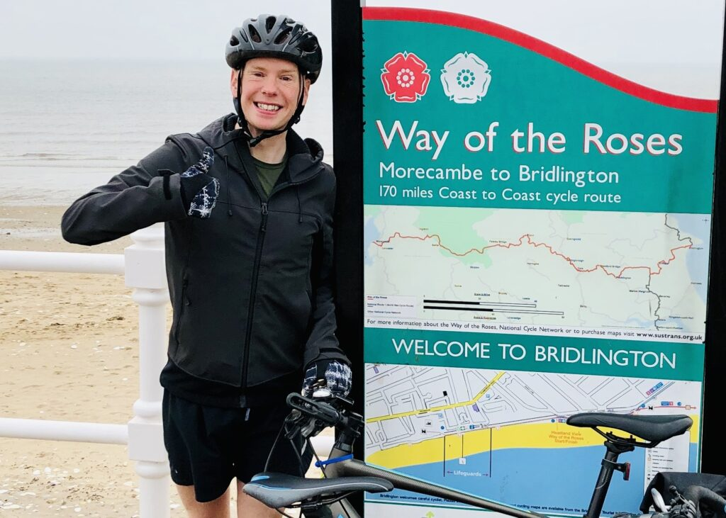
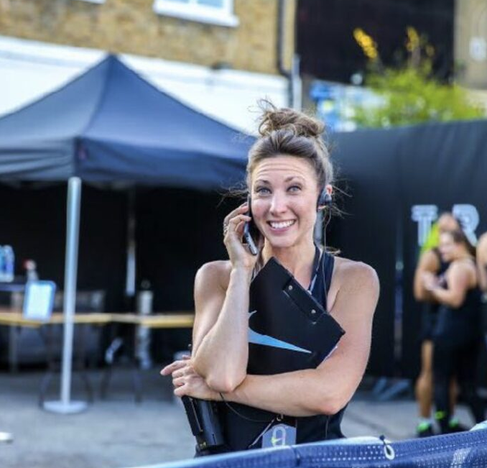
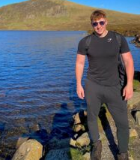
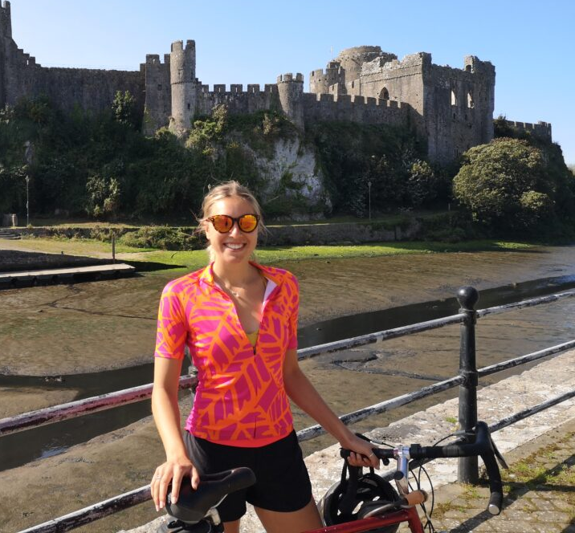
Hello from the Operations Team
The Threshold Trail Series (Dulux Race to the King, Race to the Tower and Race to the Stones) will be run by:
Natasha Addison and Richard Parr
Supported by Dave Sommerville, Adam Long and Lou Maloney.
Lou Maloney will be your main contact for the summer.

Slide 3
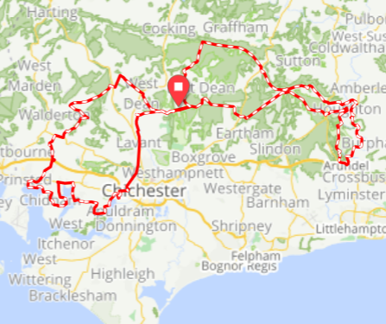
Event Overview
New Format
Figure of 8 route
Goodwood Racecourse
Route distance – 101.5km
Loop One: 50km
Loop Two: 51.5km
Seven Pit Stops

Slide 4
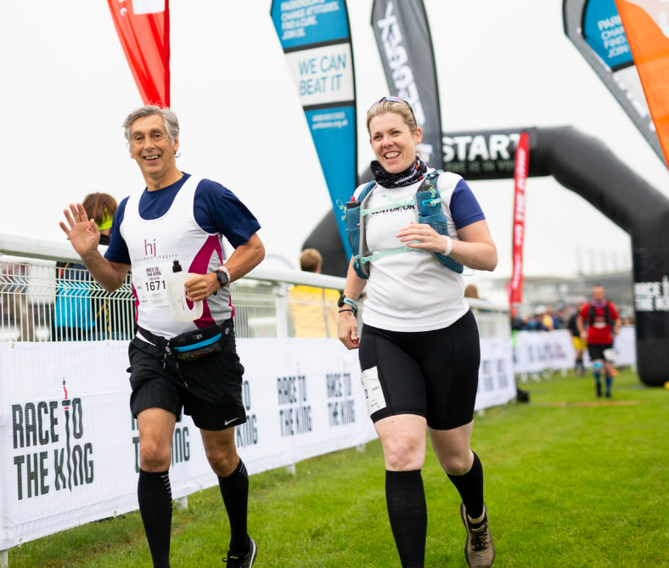
Our Participants
Participant packages
1,500 in total taking part for 2022
Non-Stop
Weekend
Day 1 or Day 2 Only
Marathon Weekender

Slide 5
Sponsors & Partners

Slide 6
What to expect on the event
There will be a volunteer check in area – t-shirts, hi-vis & wristbands can be collected here
On arrival ask for Lou Maloney
Meal times and breaks: taken on rotation
Check with Lou Maloney (Volunteer Manager) or your Pitstop Manager on the event about when to stop for dinner, shower, sleep and at what time you need to be ready in the morning.

Slide 7
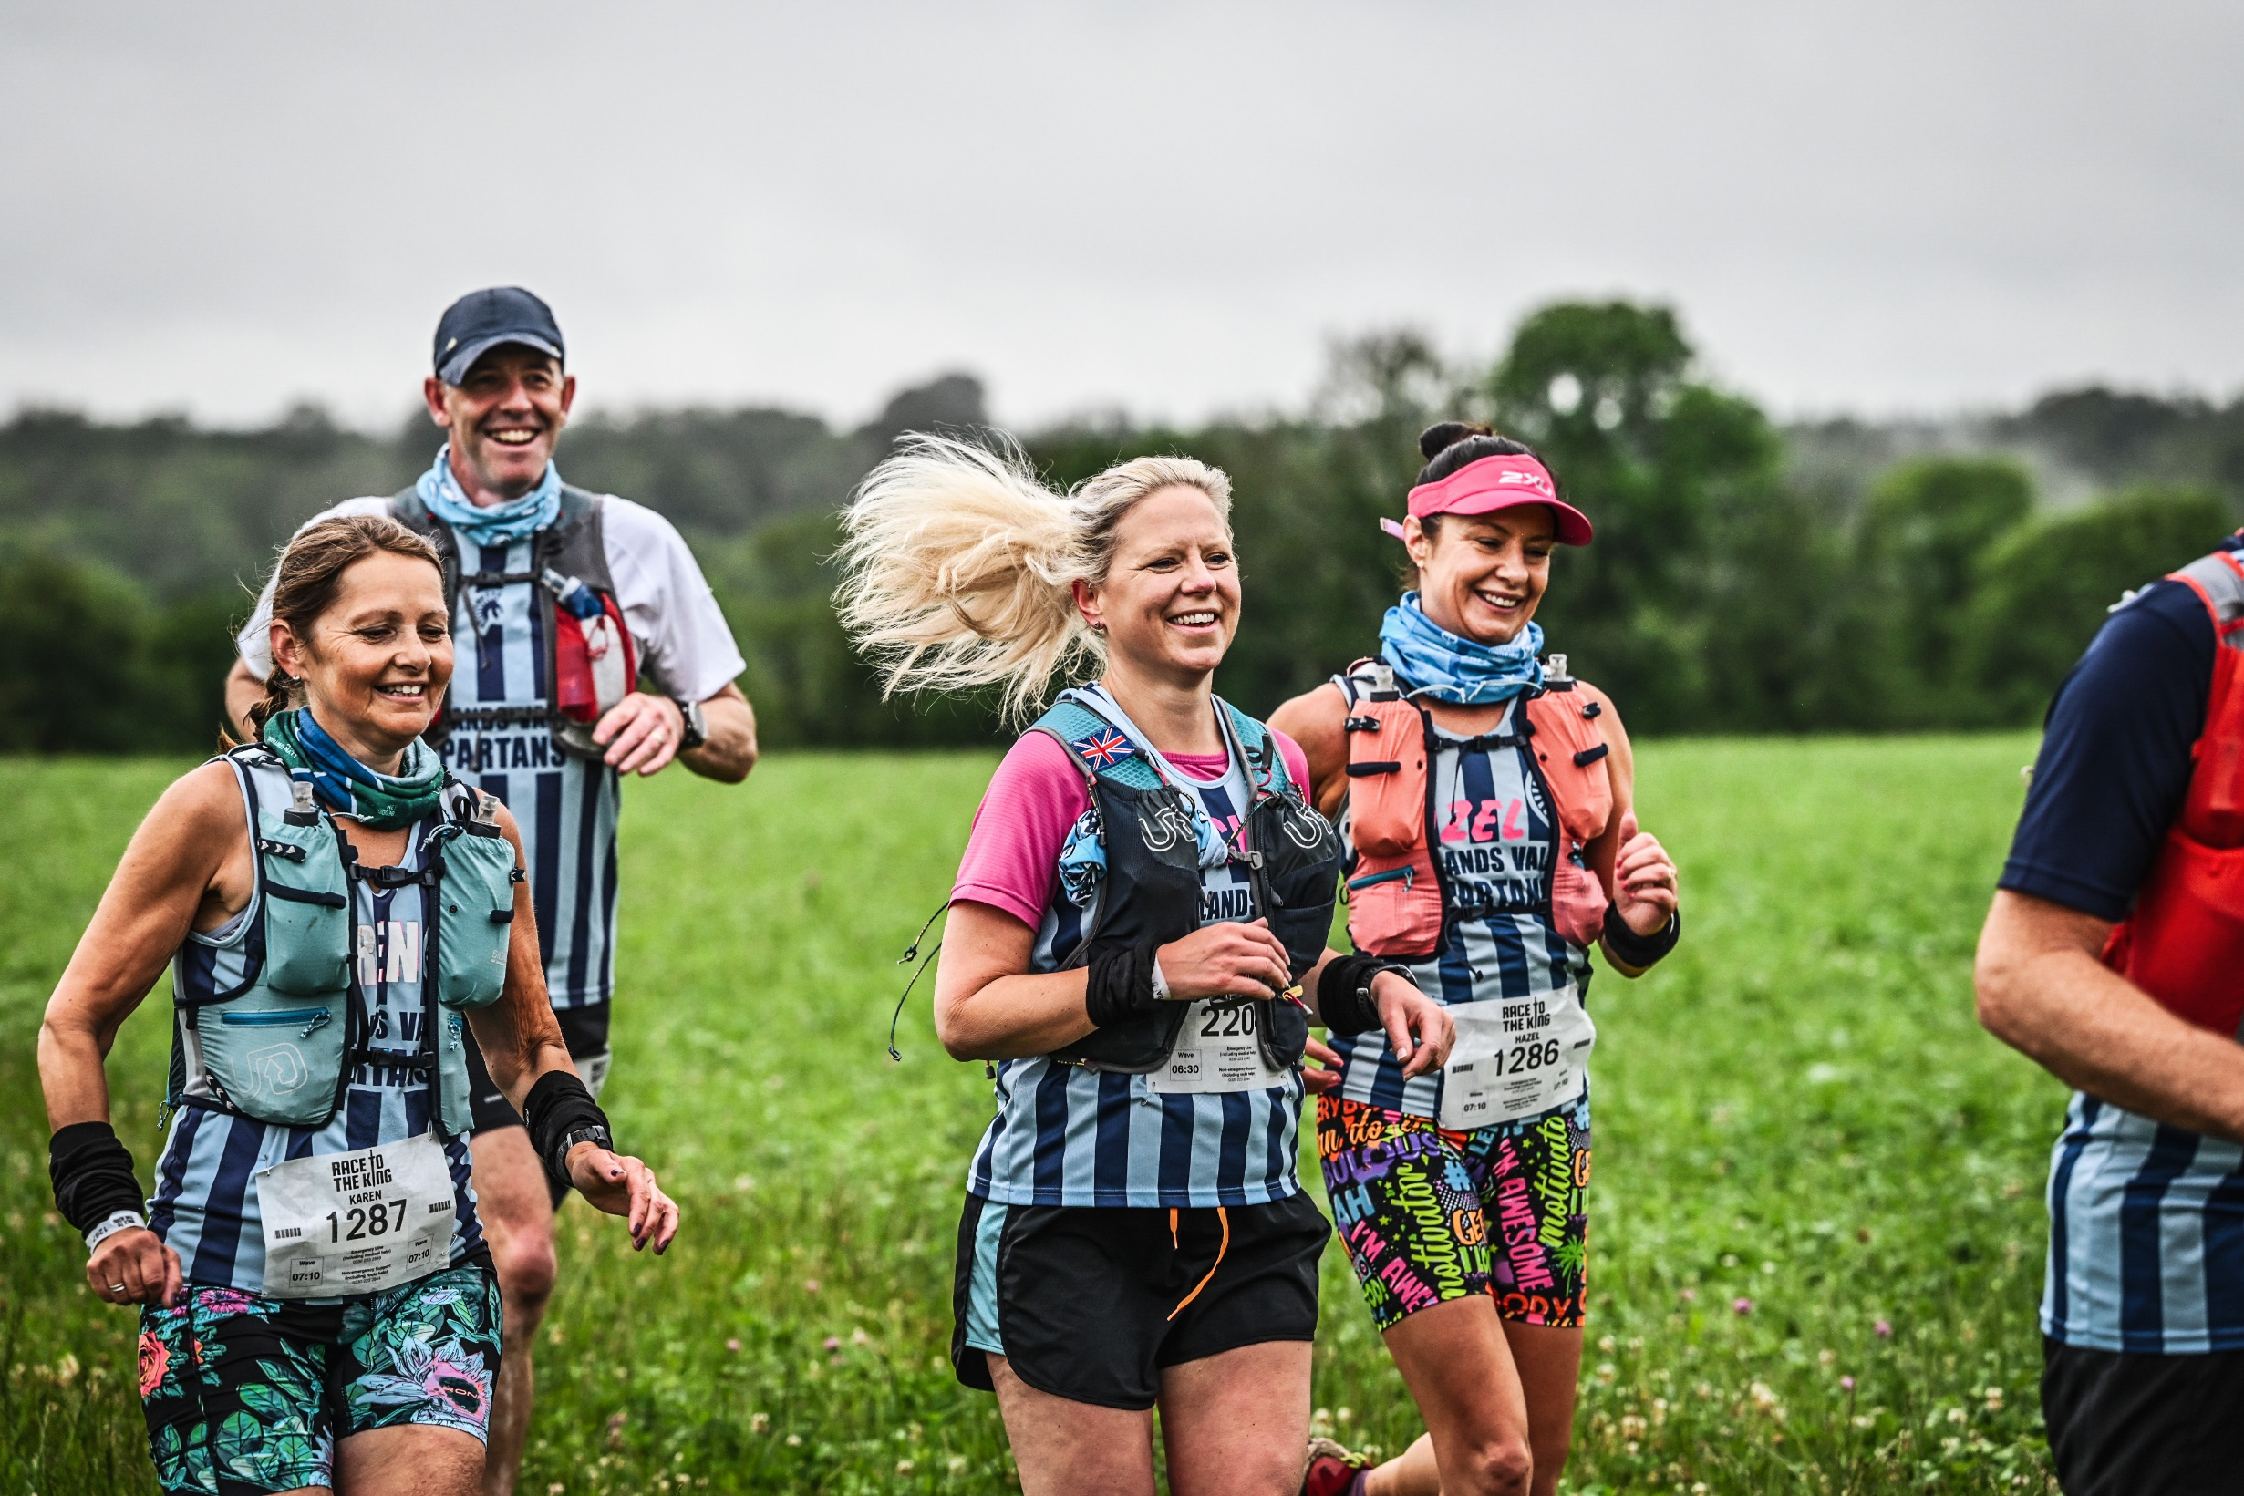
How will I get there?
Option 1: You can arrive Friday evening at Goodwood Racecourse and camp with us
Option 2: Or you can go straight to your location on Saturday/Sunday morning
Travel Expenses
You can expense your travel costs up to £100. Fuel is 45p per mile.
In an effort to be sustainable please try to lift share – you can arrange this by joining and posting in the Volunteer Facebook Forum. Or drop me an email.
You have to run there – of course!

Slide 8
What, where & when do I eat?
Catering is provided for all volunteers
Race to the King will be completely vegetarian
Dietary requirements will be catered for
There will be water refill points, coffee & tea
Our top tips:
Don’t forget to bring a water bottle – hydrate!
Try to take breaks when there are quiet lulls – you never know when it will get busy!

Slide 9
What should I wear?
You will be provided with the following items to wear:
Threshold Sports t-shirt
Blue hi-vis vest
Your should also bring the following items to wear:
Your own waterproofs
Your own trousers / shorts / leggings
Your own comfy waterproof shoes

Slide 10
Where do I sleep?
Tents and camping mats will be provided
You will need to bring:
A sleeping bag
A pillow
Warm layers to sleep in
Head torch
Our top tips:
Take 5 mins to set up your tent – where possible, do this before it gets dark
Sort your clothes out for the next day prior to bedtime

Slide 11
Kit List: the essentials
Overnight | Misc
Sleeping Bag & Camping Pillow | Waterproof holdall (60-70ltr)
Sleeping bag liner (for extra warmth!) | Packing cubes / bin liners
Warm layers to sleep in! | Water Bottle
Socks | Torch / Headtorch
Towel (Quick dry, small packing) | Day Rucksack
Wash kit, toiletries & tooth brush | Personal medication
Ear plugs (there’s lots of snorers) | Sun cream
Face wipes are always handy | EMBRACE THE BUM BAG
Day time | Admin
Beanie / Cap | Torch / Headtorch
Trainers / Walking shoes (waterproof) | Laptop and laptop charger
Shorts / Trousers | Mobile phone and charger
T-shirts | Headphones
Warm clothes | Battery pack
Waterproofs (jacket & trousers) | Pen / Notebook
Sunglasses | Driving License
Socks | Wrist watch!
11
Notes:
Rain, sunshine, wind, mud, freezing fog, early mornings & late nights
Come prepared for any type of weather
Bring the kit you need to be able to do your job
Georgia & Tash’s Top Tips:
Pack ahead of time / think day by day
Think practical & comfortable

Slide 12
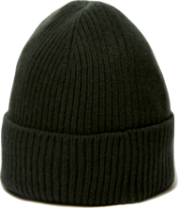
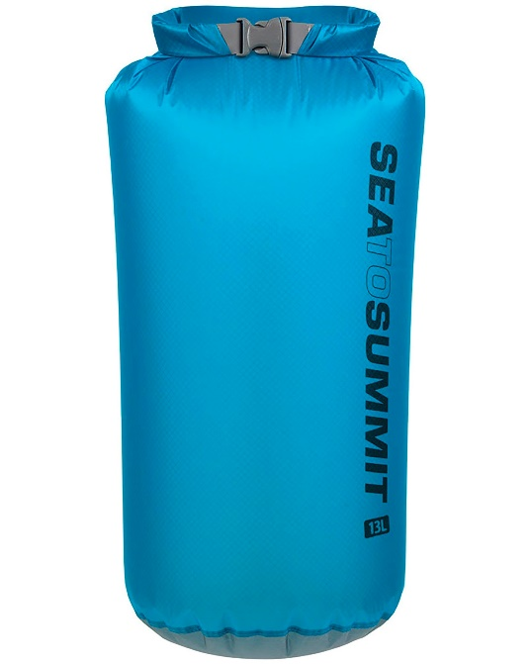
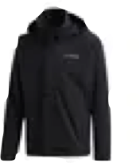
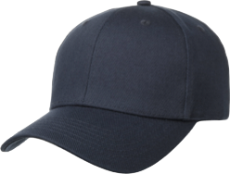
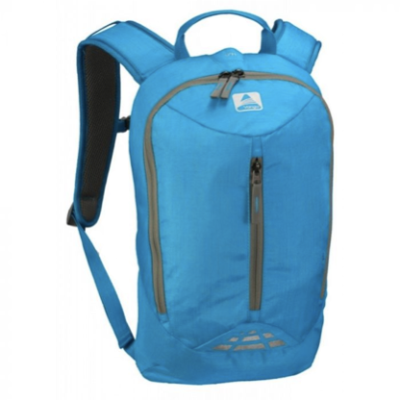
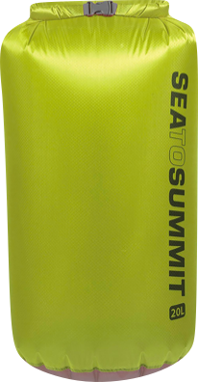
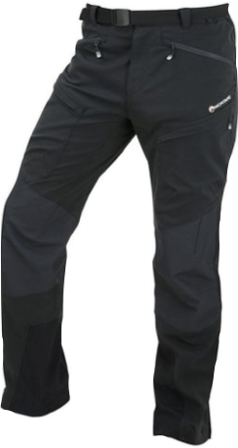
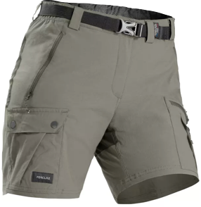
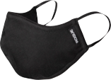
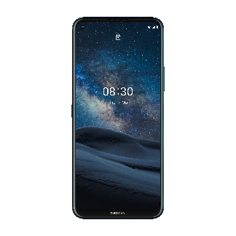
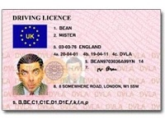
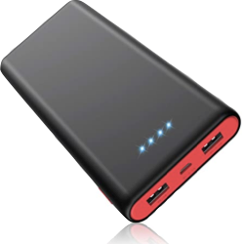
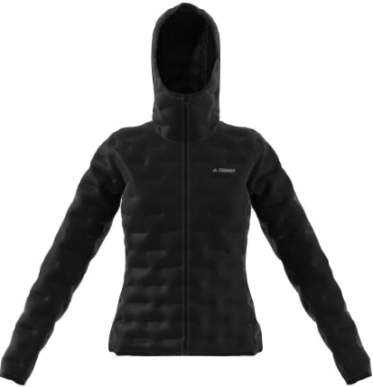
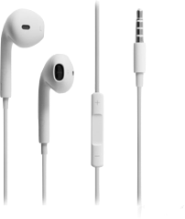
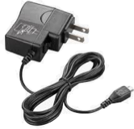
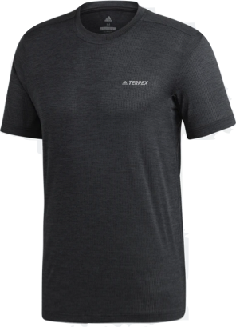
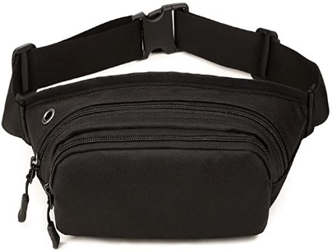
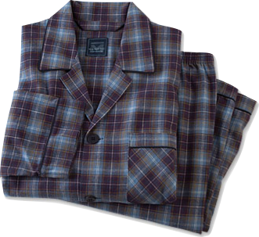
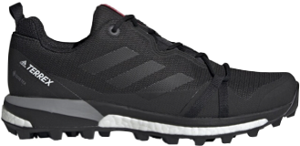
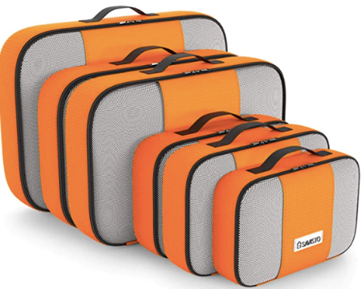
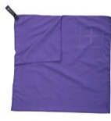
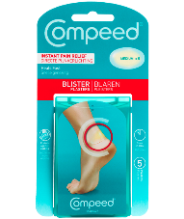
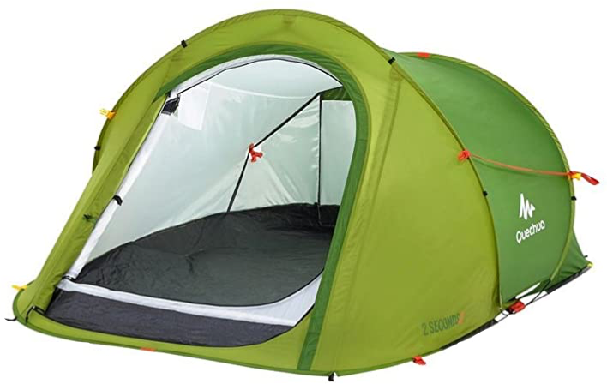
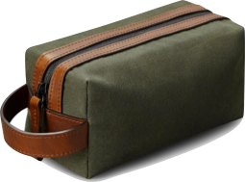
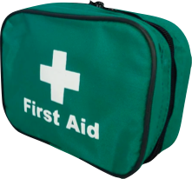
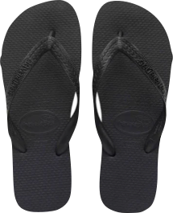
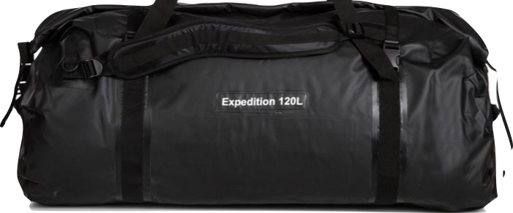
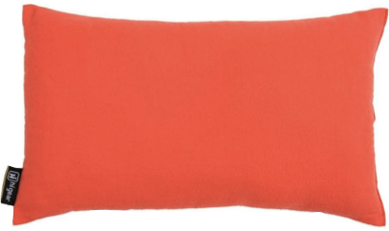
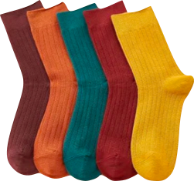
This is what your kit list looks like….
12
Notes:
This is a typical kit, however does anyone have any further items that they would add?
Top tips from the team

Slide 13
When & where do I shower?
We’re not worried about being glam but nobody wants to be smelly!
So, there are some lovely hot showers & toilets
Our top tips
Shower the night before so you’re fresh for the next morning
Wear flip flops to the shower
Sew loops onto your towel / clothes to hang up
Take a plastic bag with you for smelly clothes

Slide 14
Communication is key
Mobile Phones: Arrive with a fully charged mobile & have a charging pack so you can charge your own
Wifi / Reception: Be prepared for no wifi and sometimes limited phone reception
HIGH-VIS JACKETS
Pink - Senior Event Management
Yellow - Crew
Blue - Volunteers

Slide 15
Who to contact
999: in case of emergency
Team Leads: Report anything you
Volunteer Manager: Lou Maloney – please call me if you have any questions or issues:
07553 269691

Slide 16
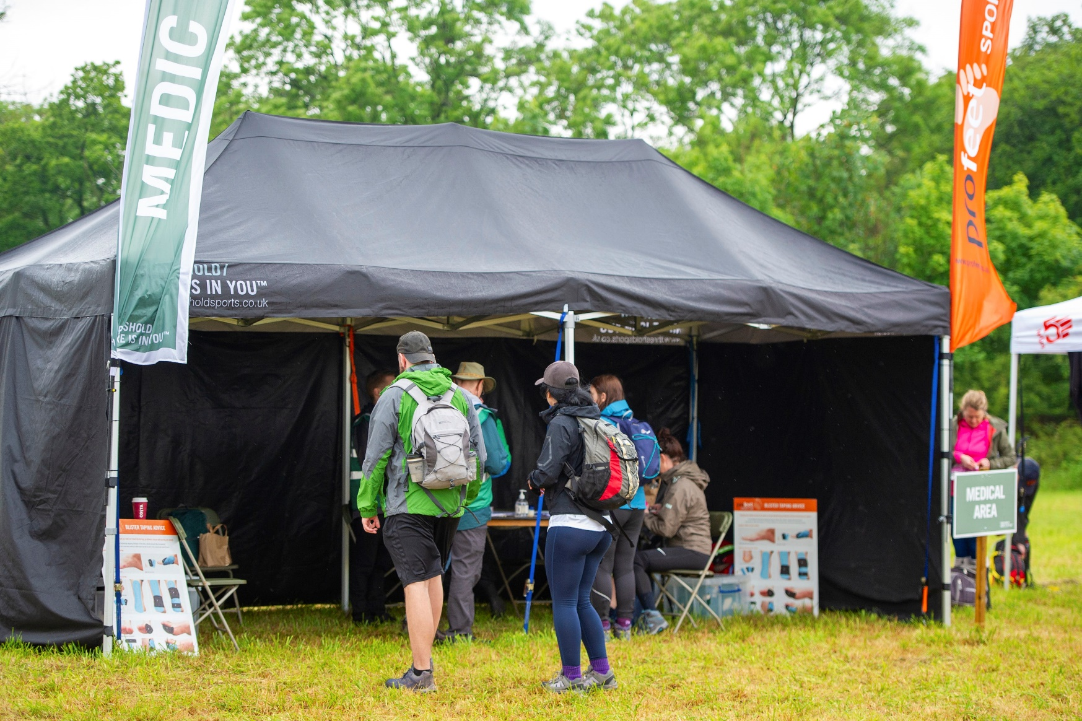
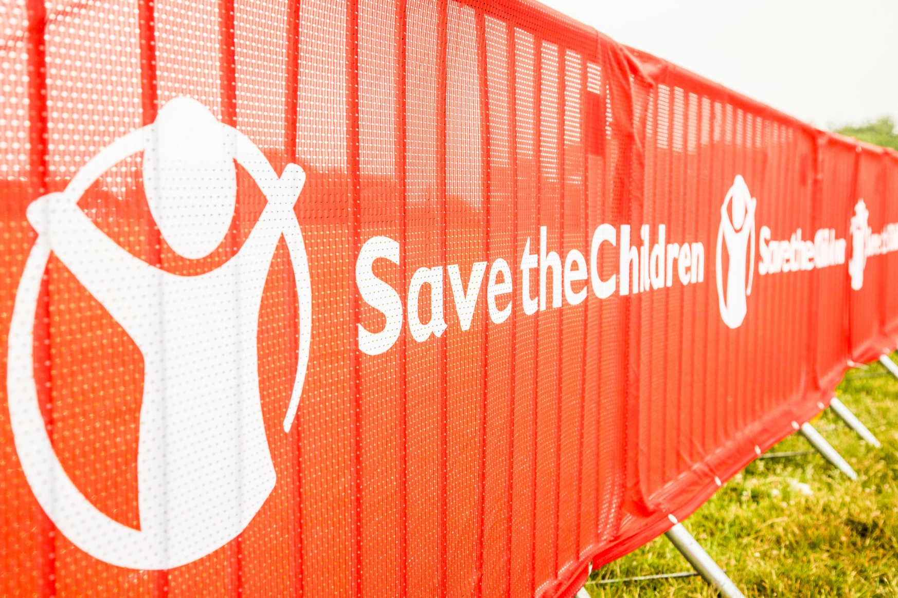
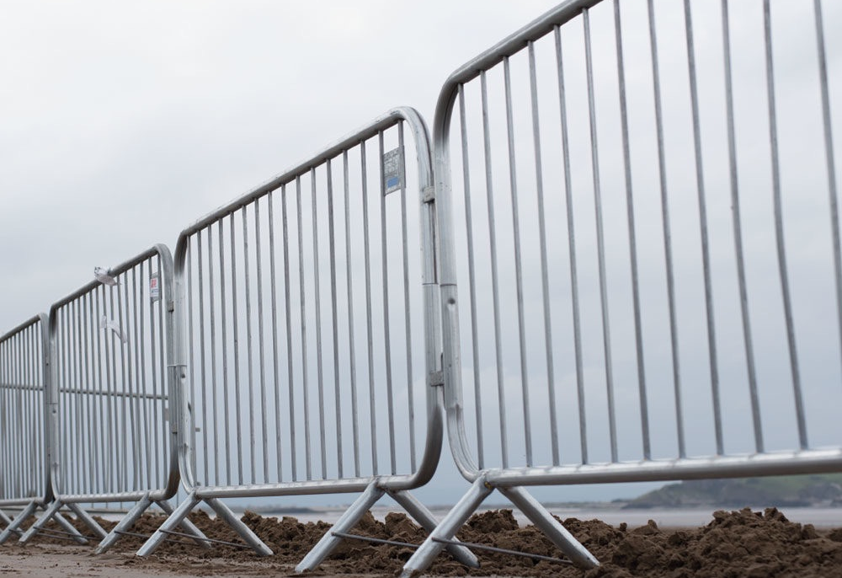
Logistical lingo
GANTRY
GAZEBO
JERRY CAN
SCRIM
CCB (CROWD CONTROL BARRIER)
BIB NUMBER

Slide 17
Without your support we wouldn’t be able to put these events on. So thank you for your time.
Lastly, please remember to HAVE FUN!
Time for questions...
Thank you

